Slide 1




Quantum State Tomography
with Mode-assisted Training
Yuan-Hang Zhang
Y.-H. Zhang and M. Di Ventra, arXiv:2112.14866

Slide 2
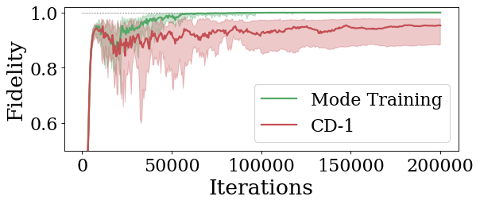
Main Results
A new method for training restricted Boltzmann machines
Explicitly injecting global information
Mitigates the difficulty in sampling
$$|ψ_{W}⟩=\frac{1}{\sqrt{N}}\left(\left|10⋯0\right\rangle +⋯+|00⋯1⟩\right)$$

Slide 3
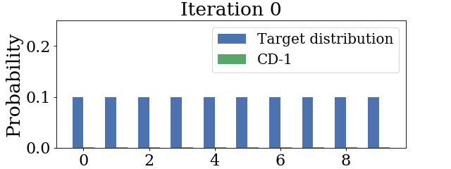
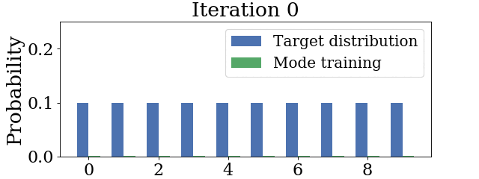
Main Results
$$|ψ_{W}⟩=\frac{1}{\sqrt{N}}\left(\left|10⋯0\right\rangle +⋯+|00⋯1⟩\right)$$
Contrastive Divergence
vs.
Mode-assisted Training
Configuration
Configuration

Slide 4
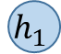
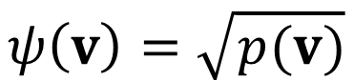


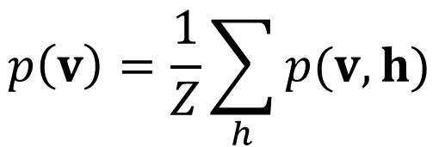

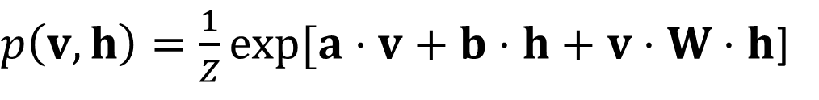
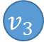
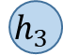
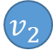
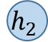
Restricted Boltzmann machine
RBM quantum state
$p\left(v, h\right)=\frac{1}{Z}exp[a⋅v+b⋅h+v⋅W⋅h$]
$$p\left(v\right)=\frac{1}{Z}\sum_{h}{p(v, h)}$$
$$v_{1}$$
$$v_{2}$$
$$h_{1}$$
$$v_{3}$$
$$h_{2}$$
$$ψ\left(v\right)=\sqrt{p(v)}$$
$$v_{4}$$
$$h_{3}$$
$$v_{5}$$
Carleo, Giuseppe, and Matthias Troyer. "Solving the quantum many-body problem with artificial neural networks." Science 355.6325 (2017): 602-606.

Slide 5
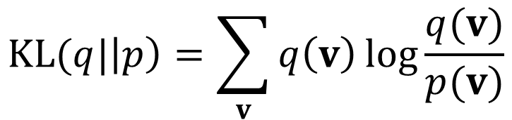


RBM quantum state tomography
Training: minimizing KL-divergence
$$KL(q|\left|p\right)=\sum_{v}{q\left(v\right)\log{\frac{q(v)}{p(v)}}}$$
$$v_{1}$$
$$v_{2}$$
$$h_{1}$$
Train
$$v_{3}$$
$$h_{2}$$
$$v_{4}$$
$$h_{3}$$
$$v_{5}$$
$$p\left(v\right)$$
$$q\left(v\right)$$
Torlai, Giacomo, et al. "Neural-network quantum state tomography." Nature Physics 14.5 (2018): 447-450.

Slide 6

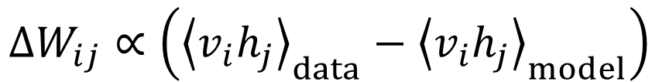

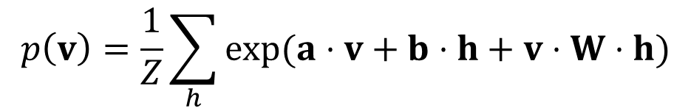
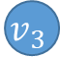
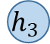
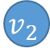
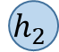


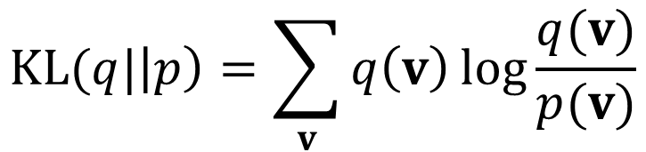
Contrastive Divergence
$$KL(q|\left|p\right)=\sum_{v}{q\left(v\right)\log{\frac{q(v)}{p(v)}}}$$
$$p\left(v\right)=\frac{1}{Z}\sum_{h}{exp⁡(a⋅v+b⋅h+v⋅W⋅h)}$$
$$ΔW_{ij}∝\left({\left\langle v_{i}h_{j}\right\rangle }_{data}−{\left\langle v_{i}h_{j}\right\rangle }_{model}\right)$$
$$v_{1}$$
$$v_{2}$$
$$h_{1}$$
$$v_{3}$$
$$h_{2}$$
Expectation w.r.t. the data distribution, tractable
Expectation w.r.t. the RBM distribution, intractable
Estimated with sampling
$$v_{4}$$
$$h_{3}$$
$$v_{5}$$

Slide 7
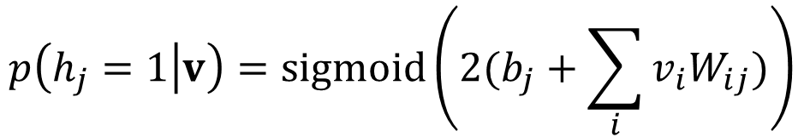
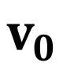
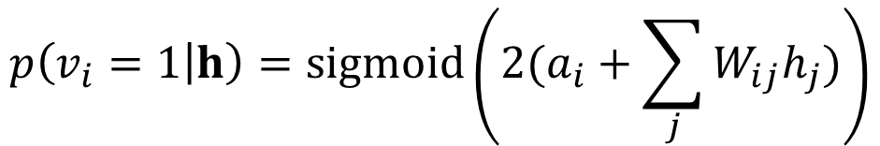
Contrastive Divergence
$$p\left(h_{j}=1 | v\right)=sigmoid\left(2(b_{j}+\sum_{i}{v_{i}W_{ij}})\right)$$
$$p\left(v_{i}=1 | h\right)=sigmoid\left(2(a_{i}+\sum_{j}{W_{ij}h_{j}})\right)$$
$$v_{0}$$

Slide 8
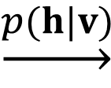
Contrastive Divergence
$$p\left(h_{j}=1 | v\right)=sigmoid\left(2(b_{j}+\sum_{i}{v_{i}W_{ij}})\right)$$
$$p\left(v_{i}=1 | h\right)=sigmoid\left(2(a_{i}+\sum_{j}{W_{ij}h_{j}})\right)$$
$$\underset{→}{p(h|v)}$$
$$v_{0}$$

Slide 9
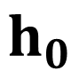

Contrastive Divergence
$$p\left(h_{j}=1 | v\right)=sigmoid\left(2(b_{j}+\sum_{i}{v_{i}W_{ij}})\right)$$
$$p\left(v_{i}=1 | h\right)=sigmoid\left(2(a_{i}+\sum_{j}{W_{ij}h_{j}})\right)$$
$$\underset{→}{p(h|v)}$$
$$v_{0}$$
$$h_{0}$$

Slide 10
Contrastive Divergence
$$p\left(h_{j}=1 | v\right)=sigmoid\left(2(b_{j}+\sum_{i}{v_{i}W_{ij}})\right)$$
$$p\left(v_{i}=1 | h\right)=sigmoid\left(2(a_{i}+\sum_{j}{W_{ij}h_{j}})\right)$$
$$h_{0}$$

Slide 11
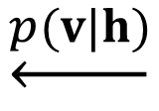
Contrastive Divergence
$$p\left(h_{j}=1 | v\right)=sigmoid\left(2(b_{j}+\sum_{i}{v_{i}W_{ij}})\right)$$
$$p\left(v_{i}=1 | h\right)=sigmoid\left(2(a_{i}+\sum_{j}{W_{ij}h_{j}})\right)$$
$$\underset{←}{p(v|h)}$$
$$h_{0}$$

Slide 12

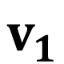
Contrastive Divergence
$$p\left(h_{j}=1 | v\right)=sigmoid\left(2(b_{j}+\sum_{i}{v_{i}W_{ij}})\right)$$
$$p\left(v_{i}=1 | h\right)=sigmoid\left(2(a_{i}+\sum_{j}{W_{ij}h_{j}})\right)$$
$$\underset{←}{p(v|h)}$$
$$v_{1}$$
$$h_{0}$$

Slide 13
Contrastive Divergence
$$p\left(h_{j}=1 | v\right)=sigmoid\left(2(b_{j}+\sum_{i}{v_{i}W_{ij}})\right)$$
$$p\left(v_{i}=1 | h\right)=sigmoid\left(2(a_{i}+\sum_{j}{W_{ij}h_{j}})\right)$$
$$v_{1}$$

Slide 14
Contrastive Divergence
$$p\left(h_{j}=1 | v\right)=sigmoid\left(2(b_{j}+\sum_{i}{v_{i}W_{ij}})\right)$$
$$p\left(v_{i}=1 | h\right)=sigmoid\left(2(a_{i}+\sum_{j}{W_{ij}h_{j}})\right)$$
$$v_{0}→h_{0}→v_{1}→h_{1}→⋯→h_{n−1}→v_{n}$$

Slide 15
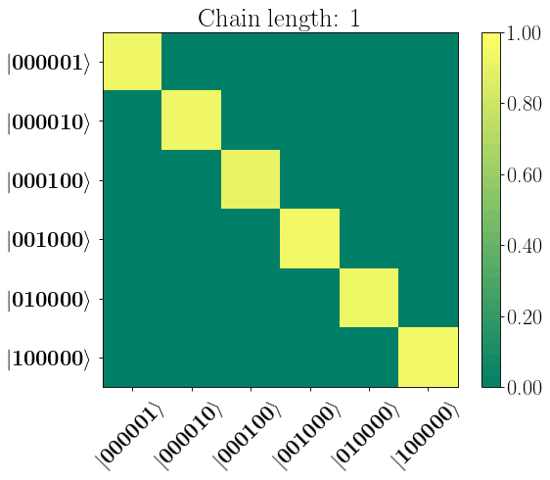
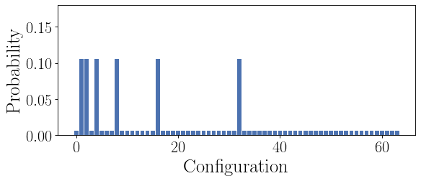
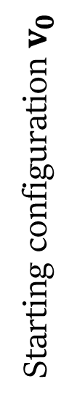
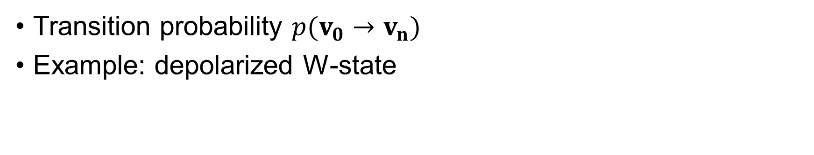
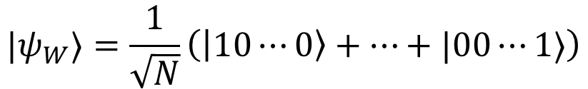
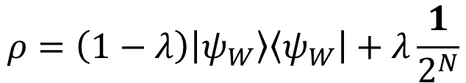
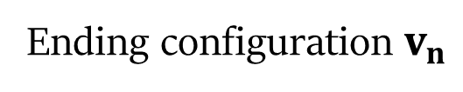
Contrastive Divergence
Transition probability $p(v_{0}→v_{n})$
Example: depolarized W-state
$$|ψ_{W}⟩=\frac{1}{\sqrt{N}}\left(\left|10⋯0\right\rangle +⋯+|00⋯1⟩\right)$$
$$ρ=\left(1−λ\right)\left|ψ_{W}\right\rangle \left\langle ψ_{W}\right|+λ\frac{1}{2^{N}}$$
Starting configuration $v_{0}$
Ending configuration $v_{n}$

Slide 16
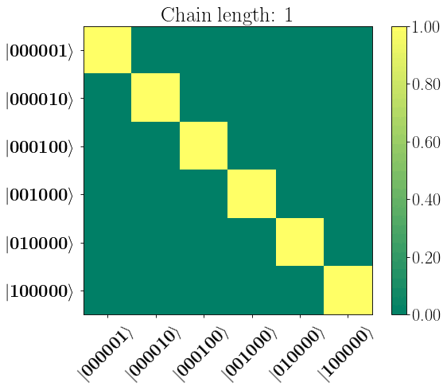
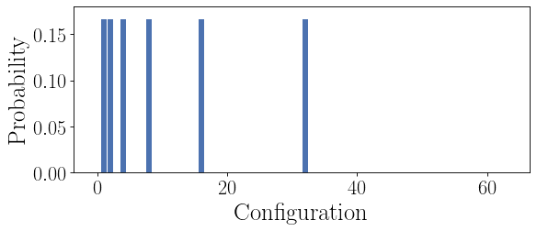
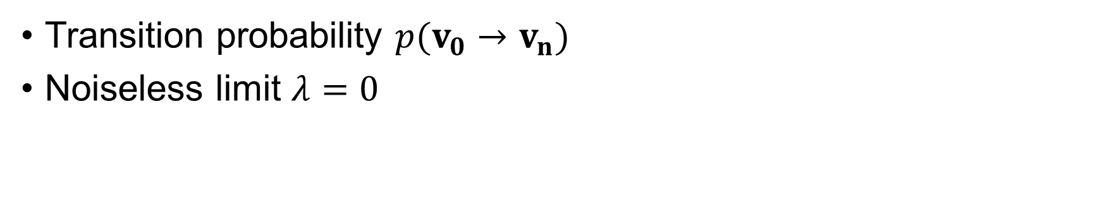
Contrastive Divergence
Transition probability $p(v_{0}→v_{n})$
Noiseless limit $λ=0$
$$|ψ_{W}⟩=\frac{1}{\sqrt{N}}\left(\left|10⋯0\right\rangle +⋯+|00⋯1⟩\right)$$
$$ρ=\left(1−λ\right)\left|ψ_{W}\right\rangle \left\langle ψ_{W}\right|+λ\frac{1}{2^{N}}$$
Starting configuration $v_{0}$
Ending configuration $v_{n}$

Slide 17
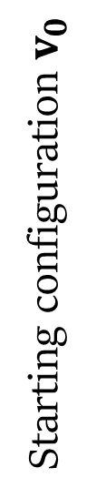
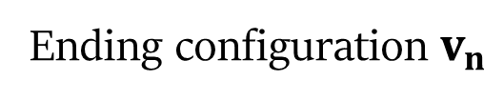
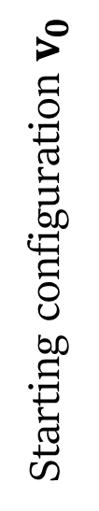
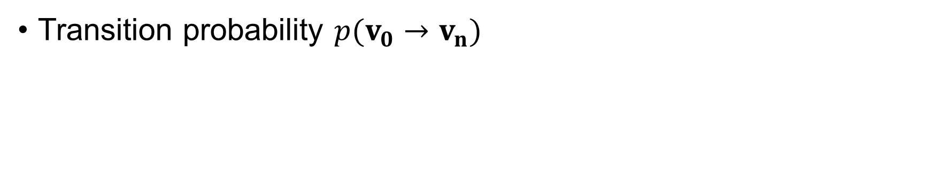
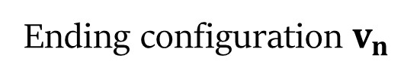
Contrastive Divergence
Transition probability $p(v_{0}→v_{n})$
Starting configuration $v_{0}$
Starting configuration $v_{0}$
Ending configuration $v_{n}$
Ending configuration $v_{n}$

Slide 18
Contrastive Divergence
Training on the 10-qubit W-state:
$$|ψ_{W}⟩=\frac{1}{\sqrt{N}}\left(\left|10⋯0\right\rangle +⋯+|00⋯1⟩\right)$$
Contrastive Divergence
vs.
Mode-assisted Training
Configuration
Configuration

Slide 19
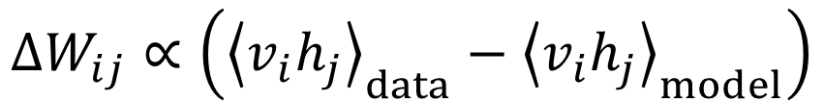
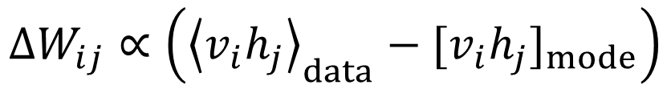
Mode-assisted training
$$ΔW_{ij}∝\left({\left\langle v_{i}h_{j}\right\rangle }_{data}−{\left\langle v_{i}h_{j}\right\rangle }_{model}\right)$$
$$ΔW_{ij}∝\left({\left\langle v_{i}h_{j}\right\rangle }_{data}−{[v_{i}h_{j}]}_{mode}\right)$$
$$v_{1}$$
Expectation w.r.t. the data distribution
Sample of RBM’s mode (ground state)
$$v_{2}$$
$$h_{1}$$
$$v_{3}$$
$$h_{2}$$
$$v_{4}$$
$$h_{3}$$
$$v_{5}$$
Manukian, Haik, et al. "Mode-assisted unsupervised learning of restricted Boltzmann machines." Communications Physics 3.1 (2020): 1-8.

Slide 20

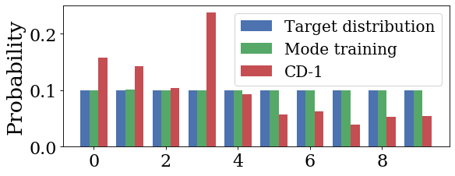
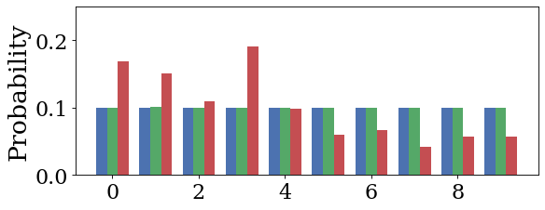
Mode-assisted training
Familiar with whack-a-mole?
Try whack-a-distribution!
Mode update pushes down the “highest” state
CD pushes down everything, in a noisy way
Mode update
Configuration
Configuration

Slide 21
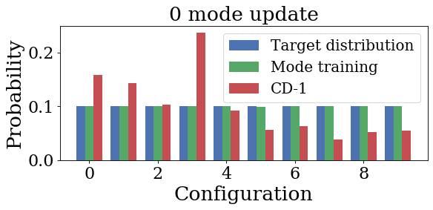
Mode-assisted training

Slide 22
Mode-assisted training
To find the mode: minimize the RBM energy
Quadratic unconstrained binary optimization
Optimization solver: MemComputing
$$E\left(v, h\right)=−\left(a⋅v+b⋅h+v⋅W⋅h\right)\sim W_{ij}v_{i}h_{j}$$
Manukian, Haik, et al. "Mode-assisted unsupervised learning of restricted Boltzmann machines." Communications Physics 3.1 (2020): 1-8.

Slide 23
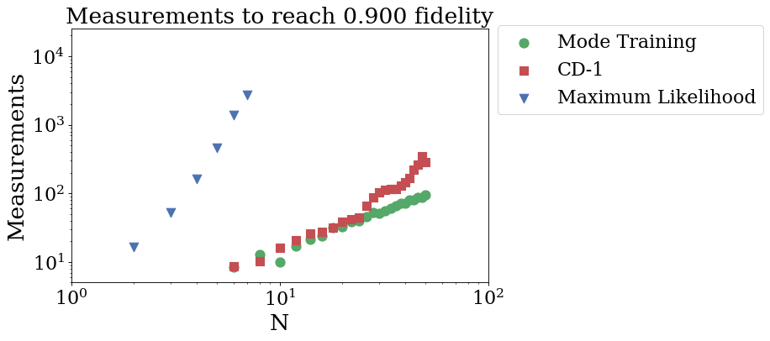
Mode-assisted training
$$|ψ_{W}⟩=\frac{1}{\sqrt{N}}\left(\left|10⋯0\right\rangle +⋯+|00⋯1⟩\right)$$

Slide 24
Take-home points
Utilizing global information: the mode
Explicitly enforce uniformity over multiple modal states
Mitigates difficulties caused by sampling
Y.-H. Zhang and M. Di Ventra, arXiv:2112.14866

Slide 25
Thank you!
Y.-H. Zhang and M. Di Ventra, arXiv:2112.14866

Slide 26
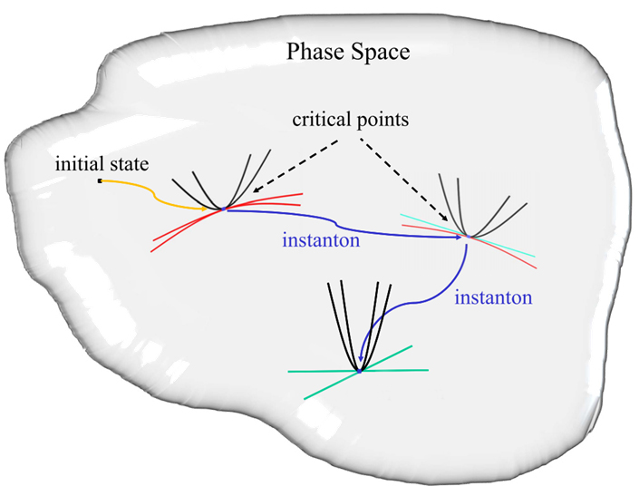
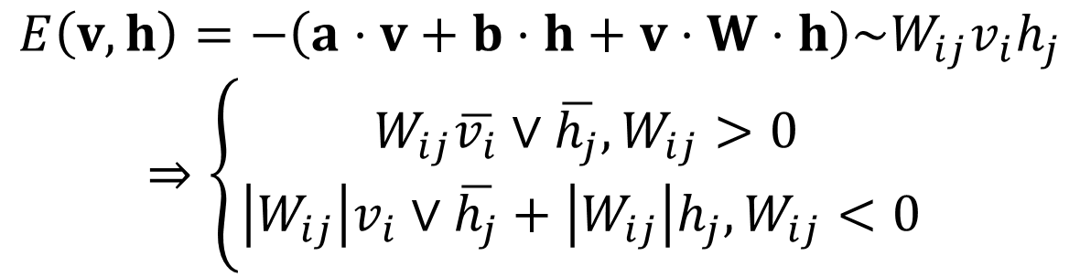
Mode-assisted training
To find the mode state: MemComputing
Minimizing the RBM energy → weighted max-SAT problem
$$E\left(v, h\right)=−\left(a⋅v+b⋅h+v⋅W⋅h\right)\sim W_{ij}v_{i}h_{j}$$
$$⇒\left\{\begin{aligned}W_{ij}\overline{v_{i}}∨\overline{h_{j}}, W_{ij}>0 \\ \left|W_{ij}\right|v_{i}∨\overline{h_{j}}+\left|W_{ij}\right|h_{j}, W_{ij}<0 \end{aligned}\right.$$
Manukian, Haik, et al. "Mode-assisted unsupervised learning of restricted Boltzmann machines." Communications Physics 3.1 (2020): 1-8.

Slide 27
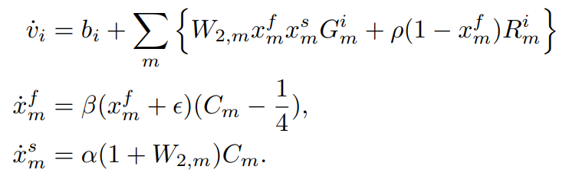


Mode-assisted training
To find the mode state: MemComputing
Minimizing the RBM energy → weighted max-SAT problem
Manukian, Haik, et al. "Mode-assisted unsupervised learning of restricted Boltzmann machines." Communications Physics 3.1 (2020): 1-8.

